Slide 1
LEGAL NEGOTIATIONS
SPRING 2024
Setting the Scene + Framing (i.e., “Perspective”
“What you say is just as important as HOW you say it.”

Slide 2
Storytelling
"The stories we tell literally make the world. If you want to change the world, you need to change your story." - Michael Margolis
Stories have the power to engage and connect with people on an emotional level.

Slide 3
Peter Pan Example
How could we re-frame the story of Peter Pan to better understand the various characters’ perspectives?
- Wendy’s perspective
- Her brothers’ perspective
- Lost Boys’ perspective
- The pirates’ perspective
- Wendy’s parents’ perspective
- Hook’s perspective
- Peter’s perspective

Slide 4
How is storytelling relevant in a negotiation context?
Engagement and Connection: Stories have the power to engage and connect with people on an emotional level. When negotiating, sharing a relatable and compelling story can capture the other party's attention and create a sense of empathy.
Building Rapport: Storytelling allows you to establish rapport and build a positive relationship with the other party. Sharing personal anecdotes or experiences can help break down barriers and create a more collaborative atmosphere.
Framing the Context: A well-crafted story can set the stage for the negotiation by providing context and background information. This can help both parties understand the motivations, challenges, and perspectives involved.
4. Illustrating Value: Use stories to illustrate the value of your proposition. Instead of listing facts and figures, share a story that demonstrates the benefits and outcomes of the agreement you're proposing.
5. Addressing Concerns: Stories can be used to address potential objections or concerns. You can share how similar challenges were overcome in the past, highlighting solutions and positive outcomes.
6. Creating a Vision: Paint a vivid picture of the future through storytelling. Help the other party visualize the potential success of the negotiation and how it aligns with their goals.

Slide 5
How is storytelling relevant in a negotiation context?
7. Overcoming Deadlocks: When negotiations hit a deadlock, a well-timed story can help break the impasse. Share a story that showcases the willingness to find common ground and collaborate toward a resolution.
8. Cultural and Emotional Appeal: Tailoring your storytelling to resonate with the other party's culture, values, and emotions can enhance your message's impact. This can help bridge gaps and foster understanding.
9. Humanizing the Process: Negotiations can sometimes feel impersonal and transactional. Sharing personal stories humanizes the process and reminds everyone involved that they are dealing with real people with emotions and aspirations.
10. Differentiating Yourself: In competitive negotiations, storytelling can set you apart from others. Your unique stories can make your proposal more memorable and distinguish you as a thoughtful and relatable negotiator.
11. Gaining Buy-In: When introducing new ideas or strategies, using stories can make them more palatable. People are more likely to buy into concepts when they're presented in a narrative that resonates with their experiences.
12. Creating a Lasting Impression: A compelling story tends to stick in people's minds longer than a list of points. Crafting a memorable story can ensure that your negotiation position lingers in the other party's thoughts.

Slide 6
How is storytelling relevant in a negotiation context?
13. Eliciting Emotions: Emotions play a significant role in decision-making. Sharing stories that evoke positive emotions can help nudge the negotiation toward a favorable outcome.
14. Conflict Resolution: Stories that showcase conflicts resolved through negotiation can demonstrate the power of finding common ground. This can encourage a collaborative mindset among both parties.
15. Adaptability and Flexibility: Stories often involve twists and turns. Use this narrative structure to highlight your willingness to be flexible and adapt to changing circumstances during the negotiation process.
Remember, effective storytelling in negotiations requires careful consideration of your audience, the context, and the specific points you want to emphasize. The goal is to create a meaningful connection and enhance the negotiation process through relatable, engaging narratives.

Slide 7

Deep Structure

Slide 8
Surface Structure:
Words
Tonality
Body Language
Gestures
What you observe

Slide 9
Deep Structure:
Words
Tonality
Body Language
Gestures
Beliefs
Values
Biases
Prejudices
Experiences
Fears
Dreams
Feelings

Slide 10
Words
Tonality
Body Language
Gestures
Words
Tonality
Body Language
Gestures
Beliefs
Values
Biases
Prejudices
Experiences
Fears
Dreams
Feelings
Beliefs
Values
Biases
Prejudices
Experiences
Fears
Dreams
Feelings

Slide 11
How to Give an Effective Opening
General Structure
Introductions
Recap background and issue(s)
Outline your interests
Work to determine the other side’s interests
Ask questions

Slide 12
Storytelling in the introduction
Why do a good story, theme, and frame matter?

Slide 13
Telling a story
Who are you?
Why are you here?
How did we get here?
What do we hope to accomplish today?
Set the scene

Slide 14


What is the idea of “framing” (in a negotiation context)?

Slide 15
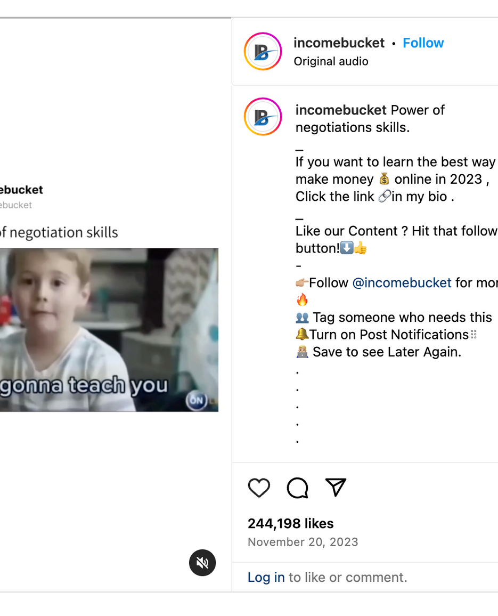
https://www.instagram.com/reel/Cz3tEOjoVfT/?igsh=Z3BjeDkza2hrbTc3

Slide 16

Framing in the context of negotiation and persuasion refers to the deliberate presentation of information or choices in a way that influences how people perceive and make decisions about a particular issue. It involves shaping the context and perspective in which information is presented to guide individuals or groups toward a specific outcome or point of view.
Framing can have a significant impact on how people interpret and respond to information, as it can highlight certain aspects while downplaying or ignoring others.

Slide 17

In the center of the picture is a FRAME, that is only covering part of the ocean and the cliff. If we expanded that frame to surround the entire picture, that would be reframing. Reframing, in a conversation, helps us see more of what is going on, helps us focus on the larger picture or our end goals, and helps diffuse tense situations.
Reframing can be used for many things when managing conflict:
- Diffusing inflammatory language
- Recasting negatives into neutral or positive statements
- Refocusing attention
- Acknowledging strong emotions in a productive manner
- Translating communication so that it is more likely to be heard and acknowledged by other parties
- Recontextualizing the dispute, providing a broader perspective

Slide 18
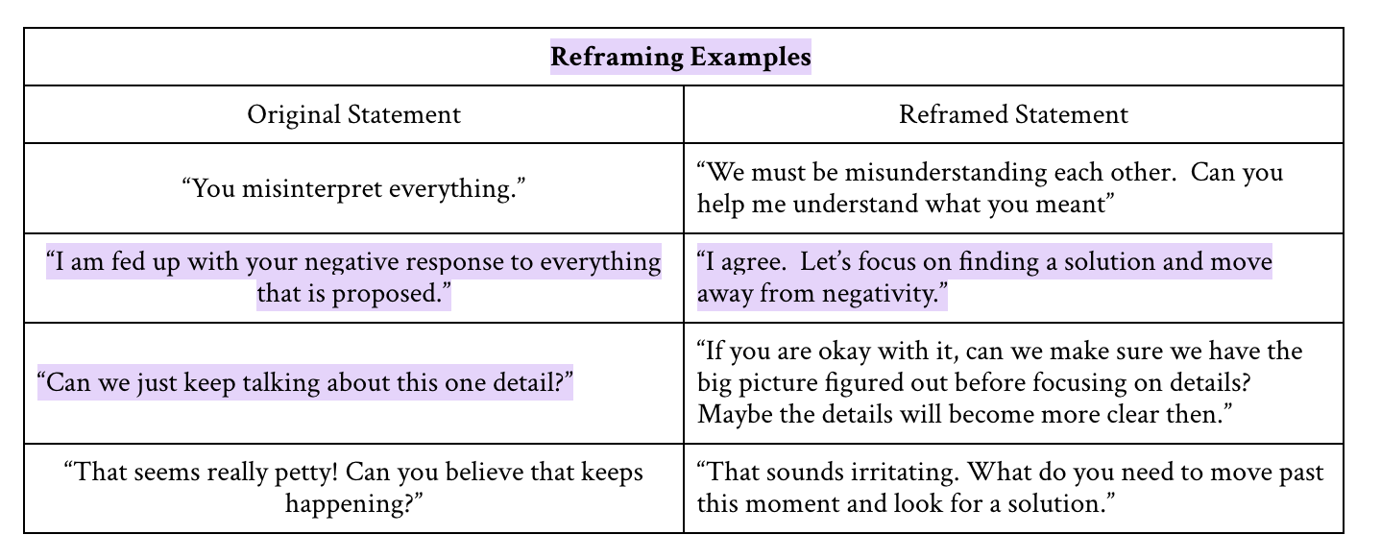

Slide 19


What are some examples of framing?

Slide 20

War on Drugs
Having to pay taxes
Climate Change (as a crisis)
Immigration
Failure
Freedom of Speech

Slide 21

War on Drugs
Traditional Frame: The "War on Drugs" emphasizes law enforcement and punishment.
Reframed: A public health approach focuses on treating addiction as a medical issue, reducing harm, and providing rehabilitation.

Slide 22

2. Taxation (as a Social Responsibility)
Traditional Frame: Taxes are a burden imposed by the government.
Reframed: Taxes are contributions to society, supporting public services like education, healthcare, and infrastructure.

Slide 23

3. Climate change (as an opportunity)
Traditional Frame: Climate change as a crisis that needs to be averted.
Reframed: Seeing it as an opportunity for innovation, job creation, and sustainable development in the renewable energy sector.

Slide 24

4. Immigration (as economic contribution)
Traditional Frame: Immigrants are a drain on resources.
Reframed: Immigrants contribute to economic growth, cultural diversity, and innovation.

Slide 25
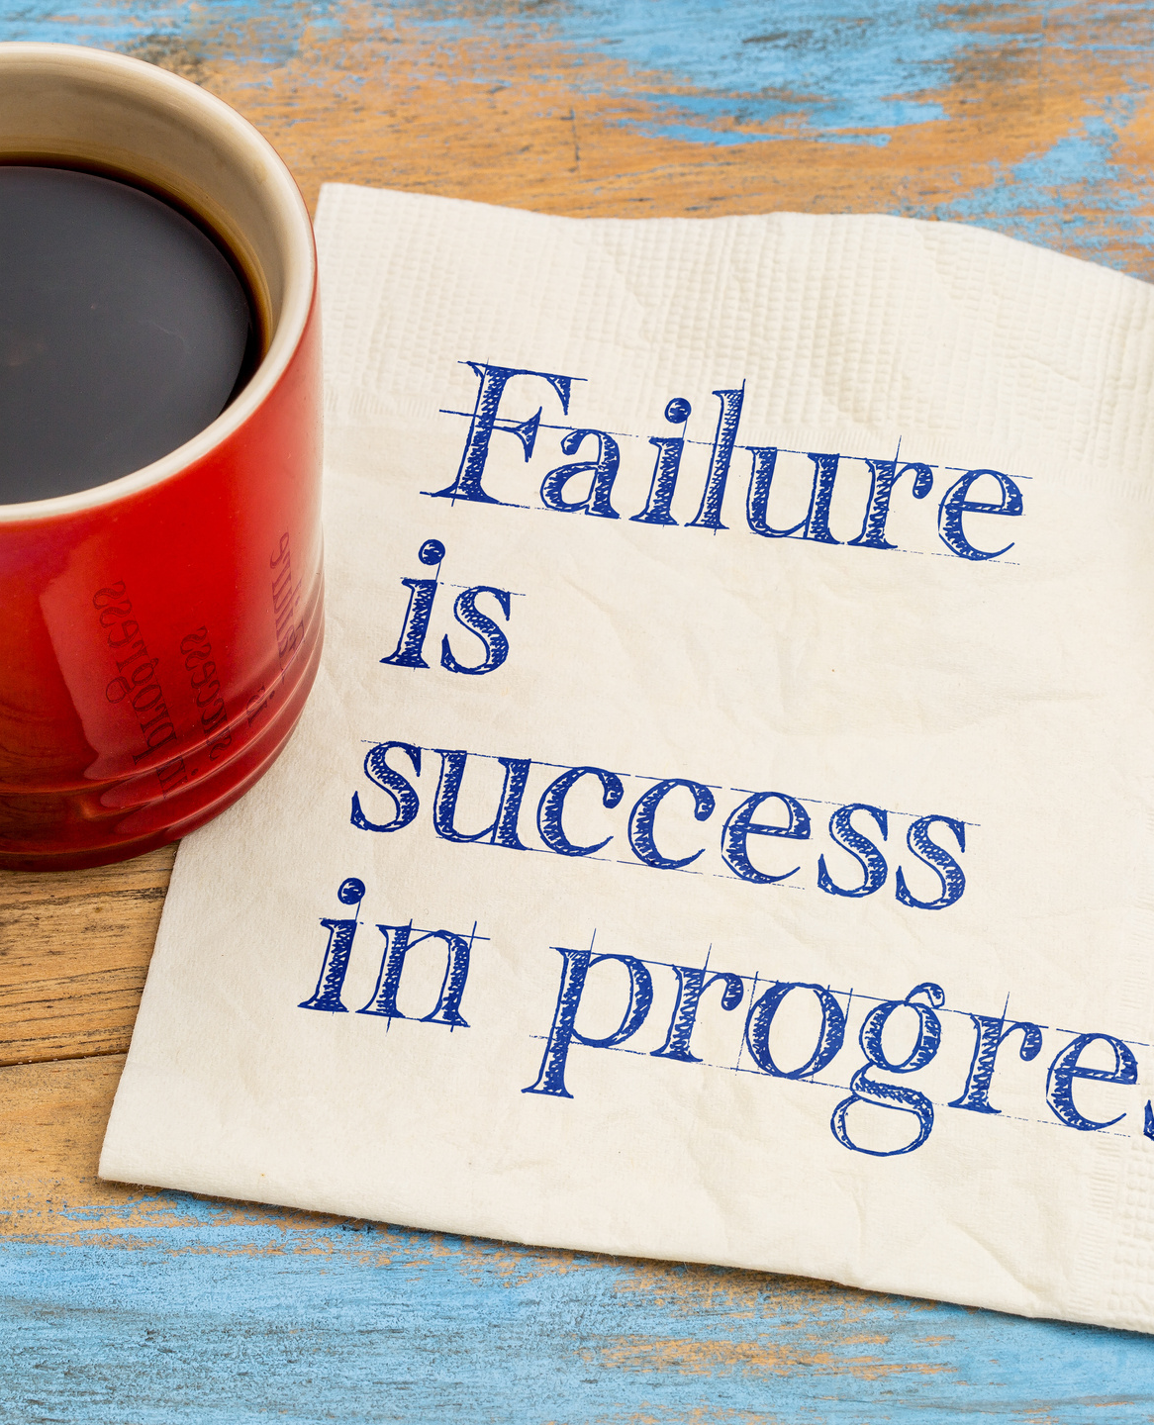
5. Failure (as learning opportunities)
Traditional Frame: Failures are setbacks.
Reframed: Failures are opportunities to learn, grow, and improve.

Slide 26
6. Freedom of Speech (v. Responsible communication)
Traditional Frame: Absolute freedom of speech.
Reframed: Emphasizing responsible communication to prevent harm or misinformation.

Slide 27
BREAK
Take a break. Sip some H20. Contemplate the meaning of life.

Slide 28
Oil Pricing

